Slide 1
Estimation of Actuation Configuration for a Multi-Actuated Blimp
Final Presentation (Semester Thesis)
Students: Matthias Krebs Advisors: Kostas Alexis
Simon Laube Markus Achtelik

Slide 2
Content
Motivation
System Overview
Problem Formulation
Parameters
System Model
Input Pattern
Optimization
Results
Simulation
Real Measurements
Ground Truth
Conclusion & Outlook

Slide 3
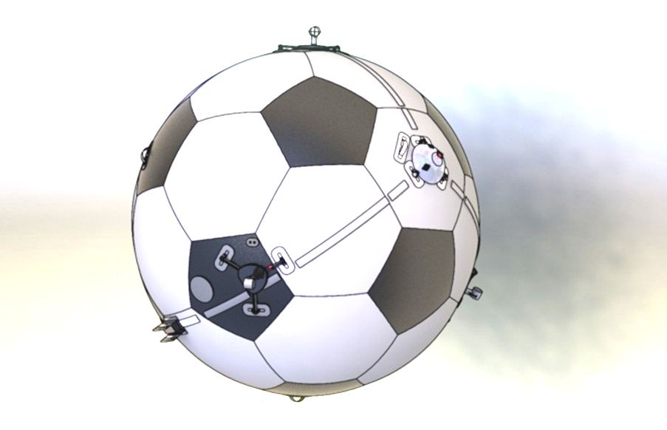
Motivation
FANCY SLIDE
Parameters

Slide 4
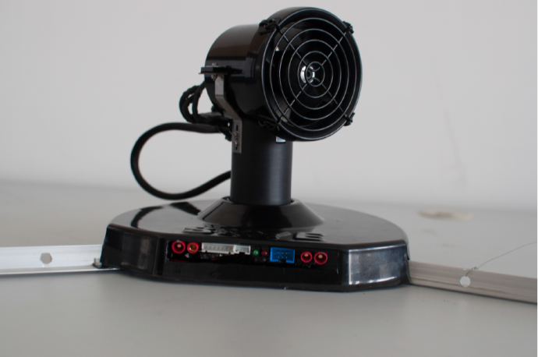
System Overview
Spherical Hull filled with Helium
4 Actuation Units (AU)
Electronics:
IMU
Controller
XBee
Rotation
Thrust

Slide 5
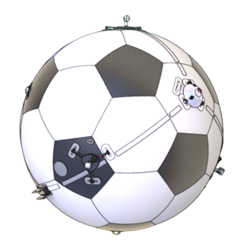
System Overview
Controller
System
Controller
Allocation
Actuation
Body Dynamics
3
4
3
4
4
Setpoint
F_{Blimp}
F_{Motors}
F_{Motors}
3
4
3
4
4
M_{Blimp}
α_{Motors}
α_{Motors}
4
Encoder
State Estimation

Slide 6
Problem Formulation
IMU Data
Actuator Input Pattern .
Parameter
Optimization Algorithm
Model
Model Output

Slide 7
Problem Formulation: Parameters
Center of Gravity R³
Actuator Arrangement
Orientation SO(3)
Inertia Tensor Sym(3)
Position R³
Radius R
Full Parameter set is only jointly observable

Slide 8
Problem Formulation: Parameters
Center of Gravity R³
Actuator Arrangement
Orientation SO(3)
Inertia Tensor Sym(3)
Position R³
Radius R
Full Parameter set is only jointly observable

Slide 9


Problem Formulation: System Model
Angular Acceleration
Assume constant actuator states
Neglect aerodynamic effects on rotation

Slide 10
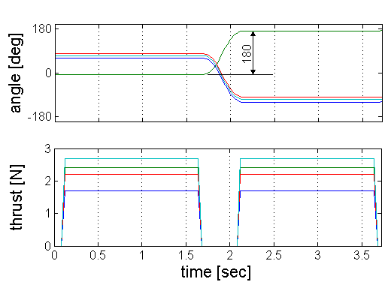
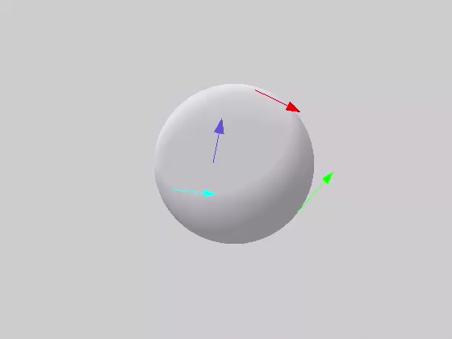
Problem Formulation: Input Pattern
Inputs must be applicable and sufficiently excited
Apply sequence of forward/backward force patterns in varying directions for all actuation units
Steady state motor dynamics

Slide 11
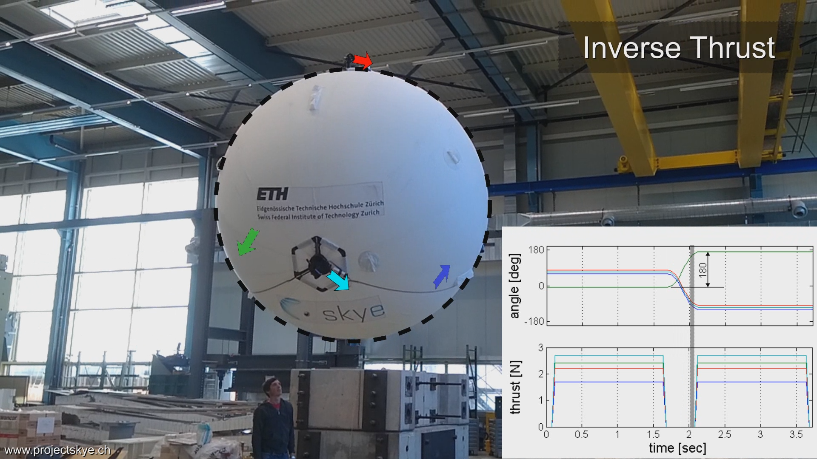

Problem Formulation: Input Pattern

Slide 13
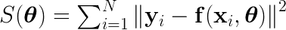

Problem Formulation: Optimization
Nonlinear Least Squares
Levenberg-Marquardt
Robust and fast gradient based minimization

Slide 14
Results
Simulation
Experimental Data
Groundtruth with Leica

Slide 15
Results: Simulation

Slide 16
Results: Experiments

Slide 17
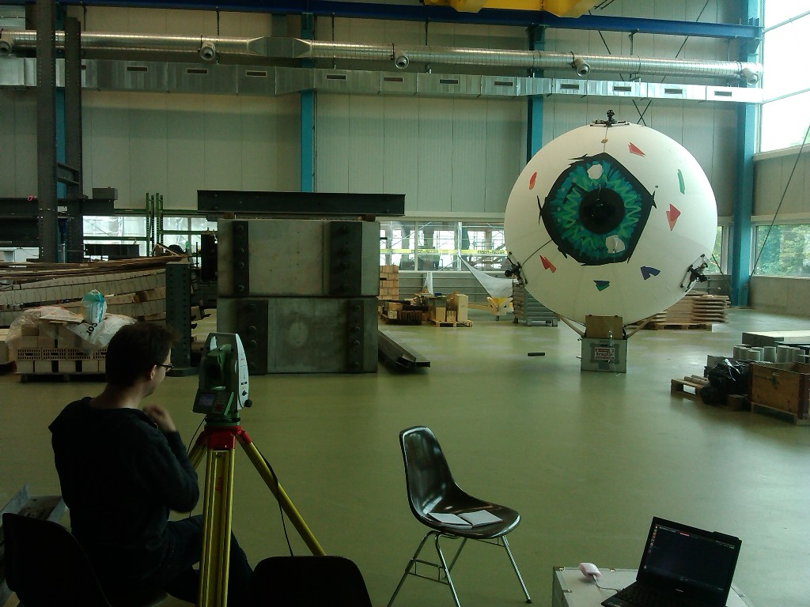
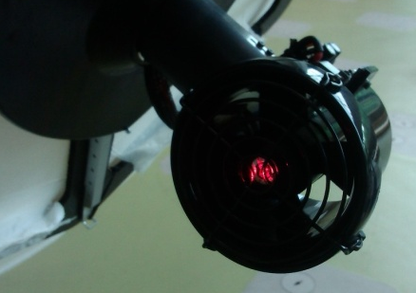
Results: „Ground Truth“ (Leica)
3 AU‘s visible at once
Use different views
Fit data to get tetrahedral‘s edge length
Residual below 0.01m

Slide 18
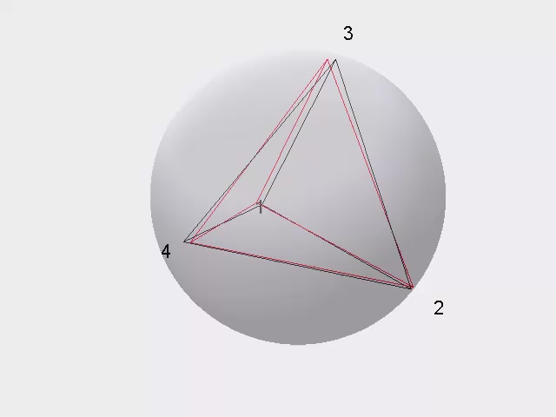
Results: Compare Leica and Batch Solution
Compare tetrahedral edge length
Relative error of batch solution
% | AU2 | AU3 | AU4
AU1 | 1.68 | 0.86 | 2.76
AU2 |  | 0.67 | 2.47
AU3 |  |  | 3.78
Leica
Batch

Slide 19
Discussion

Slide 20
Outlook

